Slide 1
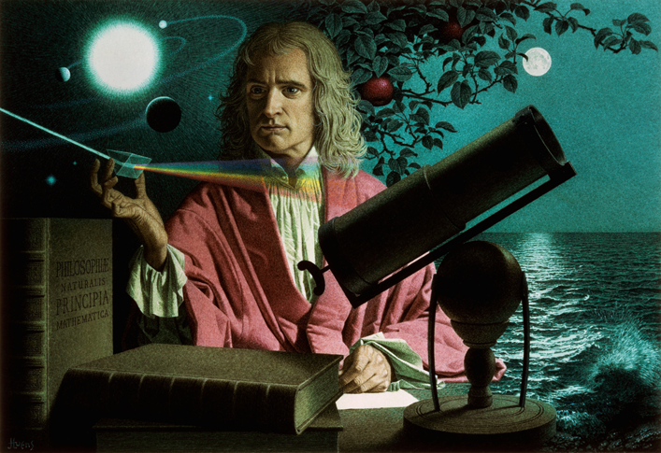
Absolutism and Revolution (1550–1850)
Topic 6 Lesson 4 The Enlightenment

Slide 2
Absolutism and Revolution (1550–1850)
Topic 6 Lesson 4 The Enlightenment
Learning Objectives
Describe how science led to the Enlightenment.
Explain the political philosophies of Hobbes, Locke, Voltaire, Montesquieu, and Rousseau.
Summarize the economic ideas of the physiocrats and Adam Smith.
Describe how Enlightenment ideas spread and influenced the arts.
Understand the role of enlightened despots.

Slide 3
Absolutism and Revolution (1550–1850)
Lesson 4 The Enlightenment
Key Terms
natural laws
Thomas Hobbes
John Locke
social contract
natural rights
philosophes
Montesquieu
Voltaire
Jean-Jacques Rousseau
laissez faire
Adam Smith
free market
free enterprise system
censorship
salons
baroque
rococo
enlightened despots
Joseph II

Slide 4
Scientific Revolution Leads to the Enlightenment
During the Scientific Revolution of the 1500s and 1600s, European scholars made advances in physics, chemistry, biology, and medicine. Like ancient scholars, the thinkers of the Scientific Revolution relied on reason, but they also developed a new “scientific method” to test their theories and observations. Using mathematics and the scientific method, they discovered a series of laws that governed the physical universe.

Slide 5
Scientific Revolution Leads to the Enlightenment
Sir Isaac Newton was a key figure in the Scientific Revolution. Among his many discoveries was gravity.

Slide 6
Hobbes and Locke on the Role of Government
During the 1600s, two English thinkers, Thomas Hobbes and John Locke, set forth ideas that were to become key to the Enlightenment. Both men lived through the upheavals of the English Civil War. Yet they reached different conclusions about human nature and the purpose and proper role of government.

Slide 7
Hobbes and Locke on the Role of Government
Hobbes Argues for Powerful Government
Hobbes believes people are brutish, cruel, and greedy
In order to escape that type of life people enter into a social contract where they give up freedom for organized society
He wrote the Leviathan which talks about this
Locke Focuses on Natural Rights
Locke believes people are reasonable and moral
He believes people have natural rights: life, liberty, property
He believes that government has a responsibility to the people it governs, if it fails then the people can overthrow it
He writes Two Treatises in Government, in which he explains that people create govt. to protect natural rights

Slide 8
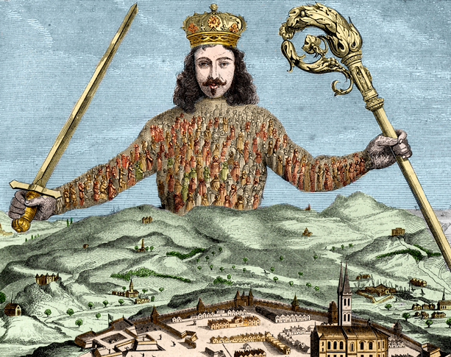
Hobbes and Locke on the Role of Government
This illustration from Thomas Hobbes's book Leviathan reflects his belief in a powerful ruler. The monarch rises above all society, just as the mythological Leviathan, or sea monster, rises above all the seas.

Slide 9
The Philosophes
In the 1700s, France saw a flowering of Enlightenment thought. French philosophes (fee loh ZOHFS), or philosophers, felt that nothing was beyond the reach of human reason. As they examined ideas about government, law and society, they called for reforms to protect people’s natural rights. Their ideas, like those of Locke, would shift political thought and strongly influence the development of democratic-republican government.

Slide 10
The Philosophes
Montesquieu Calls for Separation of Powers
1748 Montesquieu writes The Spirit of the Laws which says the best way to protect liberty was to divide the govt power into 3 branches: the executive, legislative, and judicial. They would keep each other in check
Voltaire Supports Freedom of Thought
Defends the idea of freedom of speech, by writing to battle injustice, corruption, inequality, slavery, even though he was imprisoned and forced into exile
Diderot Edits the Encyclopedia
He will explain ideas on topic like government, philosophy, and religion. He will have articles by leading thinkers of the day like Voltaire and Montesquieu. The French govt and the Catholic Church will try to ban the books and stop the publishing of more but fail

Slide 11
The Philosophes
Rousseau Promotes the Social Contract
In 1762 Rousseau writes the Social Contract. In it he says that society has too many limitations on people’s behavior. He believes some controls were necessary but they should be minimal. Government that had been freely elected should impose those controls. The good of the community should be placed above individual interests
Women and the Enlightenment
Women had natural rights but they were limited to home and family according to these philosophers. Mary Wollstonecraft wrote A Vindication of the Rights of Women, in which she argues for equal education for boys and girls. Education gave women the tools needed to participate equally with men in public life. Her ideas will influence the women’s movement later

Slide 12
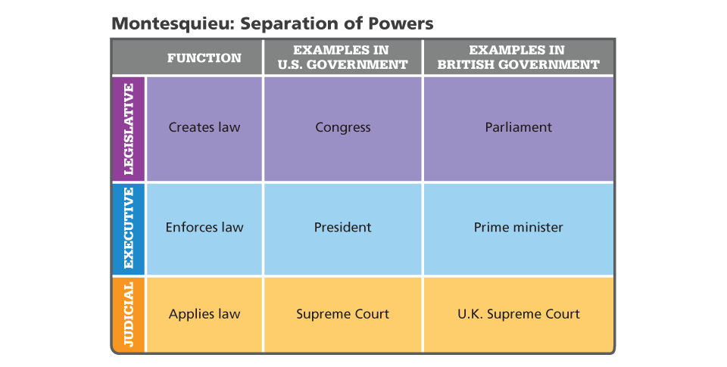
The Philosophes
Montesquieu believed in the separation of the powers of government into branches. Who currently heads the executive branch of government in the United States?

Slide 13
New Economic Ideas
French thinkers known as physiocrats focused on economic reforms. Like the philosophes, physiocrats based their thinking on natural laws. The physiocrats claimed that their rational economic system was based on the natural laws of economics.

Slide 14
New Economic Ideas
Laissez-Faire Economics
Physiocrats rejected mercantilism, believed government should interfere as little as possible with trade. They also believe in free trade and no tariffs
Adam Smith and The Wealth of Nations
In his book he argues that the natural forces of supply and demand should be allowed to operate and regulate business. He believes in Laissez-Faire economics.
He believes that government had a duty to protect society, administer justice, and provide public works

Slide 15
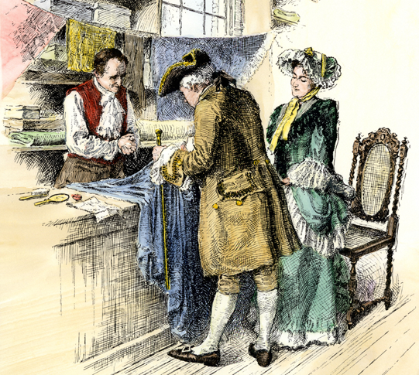
New Economic Ideas
During the American colonial era, the British government followed mercantilist principles and attempted to control colonial trade. Physiocrats rejected mercantilism and argued that governments should interfere very little in the economy.

Slide 16
Spread of Enlightenment Ideas
From France, Enlightenment ideas flowed across Europe and beyond. Everywhere, thinkers examined traditional beliefs and customs in the light of reason and found them flawed. Literate people eagerly read Diderot’s Encyclopedia as well as small pamphlets turned out by printers that discussed a broad range of issues. More and more people came to believe that reform was necessary in order to achieve a just society.

Slide 17
Spread of Enlightenment Ideas
Writers Confront Censorship
The Church and governments are going to censor writers and the ideas of the Enlightenment
Writers are going to use fiction to disguise their ideas and have them spread. Works like The Persian Letters, Candide, and Gulliver’s Travels are examples of this
Salons Spread Ideas
These are informal social gatherings between nobles, middle class citizens, artists, philosophers, writers meet to exchange ideas about the Enlightenment
Slow Change for the Majority
At first everything stays the same for the peasants but by the 1700’s these ideas of equality and social justice will make its way into the conversation. Some will be for, others against.

Slide 18
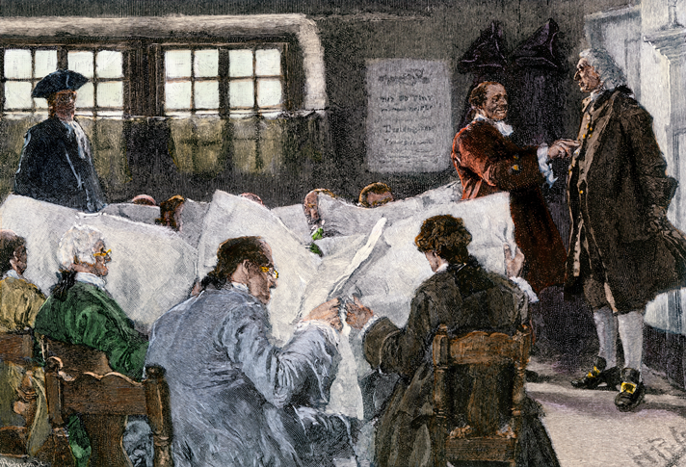
Spread of Enlightenment Ideas
Enlightenment ideas spread through the printing of pamphlets and newspapers available to citizens.

Slide 19
Arts and Literature of the Enlightenment
In the 1600s and 1700s, the arts evolved to meet changing tastes. As in earlier periods, artists and composers had to please their patrons, the men and women who commissioned works from them or gave them jobs.

Slide 20
Arts and Literature of the Enlightenment
Changing Styles in Art and Architecture
Art will change from the Baroque style, a very ornate, colorful, enthusiastic style to Rococo. Rococo is lighter, more personal style of painting. Pastels will be used more, and subjects will be in charming rural settings with happy servants and pets. Its will be criticized for its superficiality by the philosophers.
New Trends in Music
New forms of music will happen at this time like the ballet and opera
Notable composers from this time will be Bach, Handel, and Mozart
The Novel Takes Shape
People will like novels written in straight prose about their own times
Robinson Crusoe will be written at this time.

Slide 21
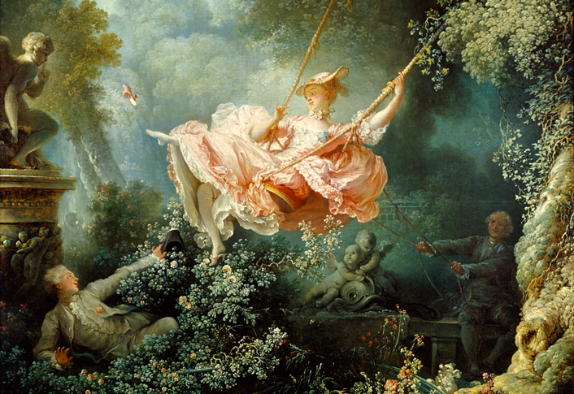
Arts and Literature of the Enlightenment
The Swing, by French painter Jean-Honore Fragonard, is a masterpiece of rococo art.

Slide 22
The Enlightened Despots
Discussions of Enlightenment theories enlivened the courts of Europe. Philosophes hoped to convince European rulers to adopt their ideas and introduce reforms. Some monarchs did accept Enlightenment ideas. They became enlightened despots, or absolute rulers who used their power to bring about political and social change.

Slide 23
The Enlightened Despots
Frederick the Great
King of Prussia, is friends with Voltaire. He will use Enlightenment ideas in his kingdom like free press, freedom of religion.
Even though he believes in Enlightenment reform, his efforts to improve government will mean more power for him.
Catherine the Great
Empress of Russia, will write to Voltaire and Diderot. She will also make some reforms based on Enlightenment ideals. Like Frederick she will not give up her power, expanding Russia’s empire
Joseph II
King of Austria. Will modernize Austria’s govt. Will impose legal and political reform, grant more rights to Protestant and Jews, allow free press, end serfdom.
Unfortunately when he dies, all of these reforms go away.

Slide 24
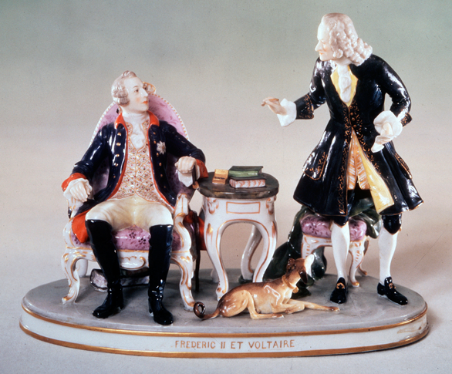
The Enlightened Despots
As an enlightened despot, Frederick the Great pursued some government reforms. This statuette shows him talking with Voltaire.

Slide 25
Quiz: Scientific Revolution Leads to the Enlightenment
Thinkers of the Enlightenment sought to use natural law to
A. find cures for major diseases.
B. solve social problems.
C. explain the workings of the solar system.
D. create lasting works of art.

Slide 26
Quiz: Hobbes and Locke on the Role of Government
Which of the following would Locke most favor?
A. republic
B. oligarchy
C. theocracy
D. absolute monarchy

Slide 27
Quiz: The Philosophes
In order to protect liberty, Montesquieu proposed that
A. people entrust their rights to a strong monarch.
B. government be divided into separate branches.
C. property be distributed equally among all people.
D. the press should have complete freedom.

Slide 28
Quiz: New Economic Ideas
Adam Smith favored an economic system in which
A. the government ensured a favorable balance of trade.
B. the government played no role in the economy.
C. prices were determined by supply and demand.
D. business put the public good ahead of the desire for profit.

Slide 29
Quiz: Spread of Enlightenment Ideas
How did philosophes and other writers avoid censorship?
A. by disguising their ideas as fiction
B. by winning the support of the aristocracy
C. by limiting access to books
D. by speaking in salons instead of writing

Slide 30
Quiz: Arts and Literature of the Enlightenment
Which of the following would be most likely considered rococo?
A. a watercolor depicting a realistic portrayal of people harvesting grain
B. a tapestry featuring delicate shells and flowers using pastel colors
C. a portrait using size and bright colors to symbolize power and glory
D. an oil painting that glorifies a historic battle and invokes religious symbolism

Slide 31
Quiz: The Enlightened Despots
Which is the best example of a monarch supporting Enlightenment reform?
A. Frederick the Great inviting Voltaire to Prussia
B. Catherine the Great expanding Russian’s empire
C. Maria Theresa modernizing the Austrian government
D. Joseph II abolishing serfdom in Austria

